Slide 1
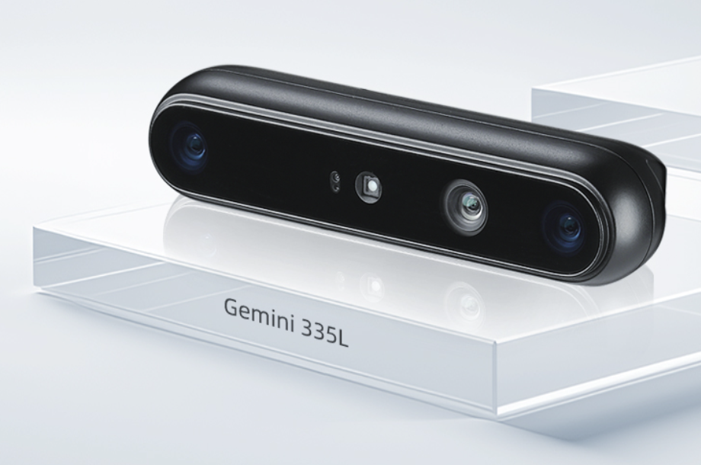
Edge Case: Orbbec Perceptor AMR Kit
The Subject: Orbbec Perceptor Developer Kit
Hardware: 3D Cameras (Gemini 335L) + NVIDIA Jetson AGX Orin
Goal: Enabling full 3D perception for industrial robots (AMRs)
The Edge Challenge: Reliability vs. Complexity
Data Overload: Multi-camera streams create massive bandwidth pressure
Battery Constraint: Industrial AMRs operate 7×24h on limited battery power
Safety Critical: Requires deterministic latency (milliseconds) for obstacle avoidance
The Role of RISC-V
It acts as the "Hidden Controller" inside Jetson Orin to solve these bottlenecks without burdening the main CPU
Notes:
For Edge Scenarios. We’ve selected the Orbbec Perceptor AMR Kit as one of our cases.
This system uses four 3D cameras powered by the NVIDIA Jetson AGX Orin to guide industrial robots.
The main challenge here is balancing complexity and reliability. Processing 360-degree 3D data requires high compute, but robots run on batteries and need to stop instantly for safety.
This is where NVIDIA's RISC-V technology comes in—acting as a 'Hidden Controller' inside the chip to manage these critical constraints."

Slide 2
The Engine: RISC-V Architecture in Orin
Microarchitecture Upgrade (vs. Falcon)
Replaced legacy Falcon with NV-RISC-V featuring Out-of-Order execution.
Impact: Significantly improves instruction throughput to handle high-speed Camera I/O with zero latency
Hardware Acceleration
1024-bit Vector Extensions: Accelerates math-heavy sensor data processing
DLA Integration: Tightly couples with specialized modules to optimize AI inference scheduling
System Security (Peregrine Subsystem)
IOPMP (Input/Output PMP): Ensures strict memory isolation for safety-critical tasks
Impact: Protects the robot's control logic from OS crashes or physical attacks
Notes:
How does NVIDIA achieve this performance? They upgraded the architecture from the old Falcon to NV-RISC-V.
Technically, this brings three major improvements to our AMR case:
First, at the Microarchitecture level, it supports Out-of-Order execution. This allows the chip to handle the high-speed Orbbec camera data much faster than before.
Second, for Acceleration, they added 1024-bit vector extensions, which speeds up the heavy math needed for sensor processing.
Third, the Peregrine Subsystem uses IOPMP technology. This strictly isolates the memory, ensuring that even if the main OS crashes, the robot's safety controls remain secure.

Slide 3
Value: Enabling Industrial-Grade Edge AI
Value to the Case (Orbbec/AMR)
Performance: High-throughput vector computation ensures millisecond-level obstacle avoidance
Stability: Optimized Firmware on RISC-V manages power states for 7×24h operation
Industry Takeaway
RISC-V serves as the "Backbone Controller" that makes high-performance AI reliable enough for factories
Unified architecture allows easy migration across NVIDIA's entire edge product line
Future Outlook
As the ecosystem matures, RISC-V may evolve from a "Hidden Helper" to a Main Processor for future low-power edge devices
Notes:
In conclusion, the value here is transforming 'Lab AI' into 'Industrial AI'.
The Vector Extensions provide the performance needed for real-time safety, while the Optimized Firmware ensures the stability needed for 24/7 operation.
It acts as the backbone controller that makes the system rugged.
Looking ahead, while RISC-V is currently a 'Hidden Helper', the trend suggests it could evolve into a Main Processor, unifying control and AI tasks completely.

Slide 4

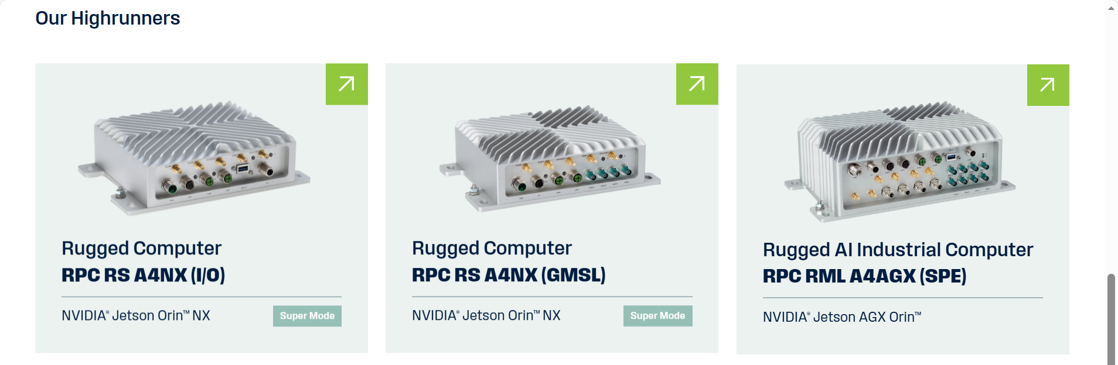
Edge Case - Syslogic Agricultural Edge Computer
Syslogic AI Vehicle Computer RM A2N: Agricultural Automation Enabler
Rugged edge computer based on NVIDIA Jetson Orin + NV-RISC-V
Hardware Highlights:
High-res cameras + RTK-GNSS module
IP67 / -30~80℃ / Anti-vibration (1000G)
Key Missions:
Real-time pest/disease detection (network-independent)
Centimeter-level positioning for agricultural machinery
Solved Edge Pain Points:
No 4G/5G in remote farmlands
Millisecond-level latency demand
Battery & harsh environment constraints
Multi-source data overload
Notes:
Product Overview: A rugged, agriculture-specific edge computing solution built on NVIDIA Jetson Orin Nano/NX, integrated with the NV-RISC-V subsystem.
Hardware Configuration: Combines high-resolution cameras (for crop monitoring), RTK-GNSS modules (for positioning), and ruggedized hardware (IP67 rating, -30~80℃ operating temperature, vibration resistance up to 1000G) to adapt to extreme farmland conditions.
Core Missions: Address two critical needs in agricultural automation:
Real-time crop pest and disease detection for farm robots, with local processing of high-resolution image data (8MB/frame) to eliminate network dependency in remote farmlands.
Centimeter-level positioning and low-latency trajectory control for agricultural machinery, enabling precise sowing, fertilization, and harvesting without cloud-based positioning delays.
Key Edge Challenges Addressed:
Lack of reliable 4G/5G connectivity in remote areas, requiring standalone data processing.
Demand for millisecond-level response to avoid trajectory deviations during machinery operation (5km/h).
Strict power constraints for battery-powered electric agricultural equipment, needing low-power computing for 7×24h continuous work.
Overwhelming concurrent data from cameras and RTK modules, requiring efficient distribution and processing.

Slide 5
The Engine for Agricultural Edge Intelligence
Microarchitecture Upgrade: Out-of-Order Execution
Zero-latency processing of camera data (120MB/s)
Hardware Acceleration: 1024-bit Vector Extensions
3x faster image preprocessing (denoising/ROI cropping)
Frees GPU for AI inference (98.2% accuracy)
Dual Advantages:
IOPMP Safety Isolation → Prevents machinery malfunction
0.3W Ultra-low Power → 25% longer equipment runtime
Key Innovation:
Synergistic Computing (RISC-V + Jetson GPU)
Notes:
Microarchitecture Innovation: Out-of-Order Execution:
Replacing legacy architectures with NV-RISC-V’s out-of-order execution design significantly boosts instruction throughput, enabling zero-latency reception and distribution of high-speed camera data (120MB/s). This eliminates lags in the "image capture-preprocessing" pipeline, ensuring a smooth 18 FPS for pest and disease detection—critical for real-time decision-making in dynamic farm operations.
Hardware Acceleration: 1024-bit Vector Extensions:
Tailored for math-intensive tasks, the 1024-bit vector extensions accelerate image preprocessing (including denoising, ROI cropping, and format conversion) by 3x compared to traditional scalar computing. By offloading these tedious tasks to RISC-V, the Jetson GPU is freed up to focus on AI inference, achieving a 98.2% accuracy rate for pest and disease recognition.
Dual Advantages: Safety Isolation + Low-Power Optimization:
Safety via IOPMP: The Input/Output Physical Memory Protection (IOPMP) feature strictly isolates the positioning and control link from the main system, preventing machinery malfunctions or 失控 caused by OS crashes or AI model anomalies—ensuring compliance with agricultural machinery safety standards (e.g., ISO 15066).
Ultra-Low Power Consumption: Modular ISA trimming (retaining only core functional instructions) reduces the NV-RISC-V subsystem’s power draw to just 0.3W (1/10 of the main CPU’s power consumption), extending the runtime of battery-powered agricultural equipment by 25% (from 8 hours to 10 hours) for all-day operations.

Slide 6
Value & Outlook: Scaling Precision Agriculture
Proven Value (Data-Driven):
Pesticide usage reduced by 65%
Crop yield improved by 12%~15%
±2cm positioning accuracy
7×24h stable operation in harsh environments
Core Advantages:
Real-time performance, synergy, safety, low power
Future Trajectory:
Short-term: Standard control subsystem for Jetson agricultural devices
Long-term: Evolve to primary processor (30%+ cost reduction)
Industry Impact: Drive precision agriculture adoption for small-to-medium farms
Notes:
Proven Application Value (Data-Driven Results):
Pest/Disease Detection: Early-stage identification of lesions smaller than 2mm with network-independent local processing reduces pesticide usage by 65% and cuts crop loss rates from 15% to 5%.
Centimeter-Level Positioning: ±2cm positioning accuracy reduces agricultural machinery trajectory repetition by 80%, improving seed utilization by 15% and boosting corn/cotton yields by 12%~15%.
Operational Efficiency: Supports 7×24h continuous work in harsh farmland conditions, reducing manual intervention and lowering labor costs by 40% for large-scale farms.
Core Advantages of NVIDIA RISC-V in Agriculture:
Real-Time Performance: End-to-end latency under 20ms adapts to dynamic agricultural machinery operations.
Computational Synergy: Seamless collaboration with Jetson GPU balances efficiency, accuracy, and cost.
Safety & Reliability: Hardware-level isolation ensures stable operation in extreme environments and system failures.
Low-Power Adaptability: Ideal for battery-powered edge devices in remote agricultural settings.
Future Development Trajectory:
Short-Term: Become the standard control subsystem for NVIDIA Jetson’s agricultural edge product line, expanding coverage to full agricultural workflows (sowing, fertilization, weeding, harvesting).
Long-Term: As the RISC-V ecosystem matures, evolve from a "hidden helper" to a primary processor for low-power agricultural edge devices, reducing hardware costs by 30%+ and enabling wider adoption among small-to-medium farms.
Industry Impact: Accelerate the transformation of traditional agriculture to smart precision agriculture, driving sustainability through reduced resource waste (pesticides, seeds, energy) and improved productivity.

